Slide 1

HBFC BANK PERSONAL LOANS BUSINESS PROJECT
KALIDINDI SREERAM CHAITANYA VARMA
GLCA DA ACADEMIC PROJECT

Slide 2
Business Problem
In the last campaign, the bank reached out to 5000 customers out of which 480 customers accepted the personal loan offer. The bank incurred a huge cost in running a marketing campaign to reach out to so many customers. We are tasked to optimise the cost of this campaign by identifying the correct target base (without a significant reduction in number of acceptance of offers). The bank can then send Personal Loan offers to these target customers who have a higher chance of accepting the offer. Based on your analysis, suggest a strategy for the management of HBFC Bank.

Slide 3
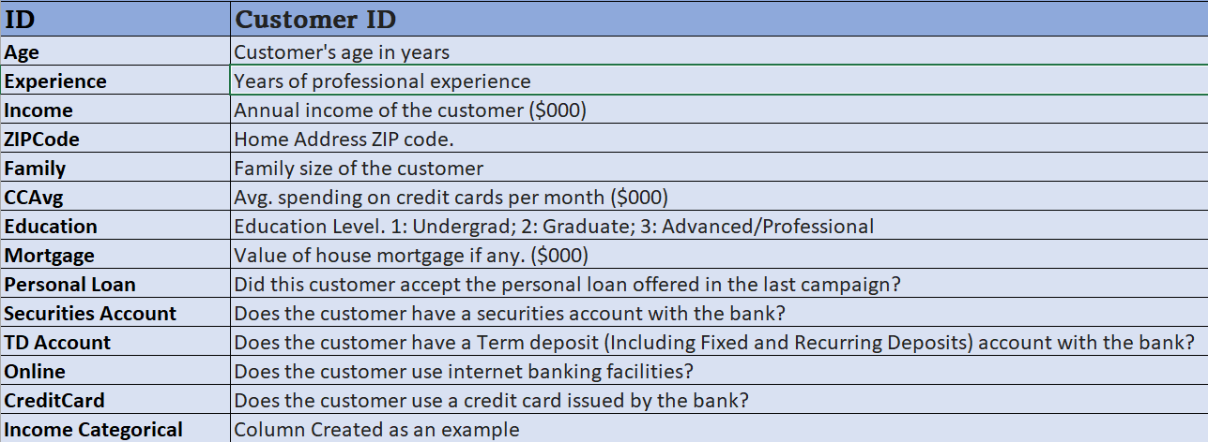
Data Description

Slide 4
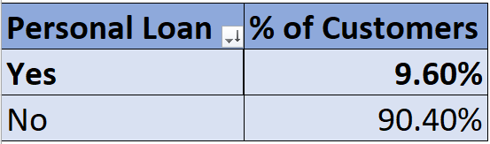
Percentage of Bank Customers who have availed Personal Loans
Only 9.60% (480) of the total 5000 bank customers availed Personal Loans.

Slide 5
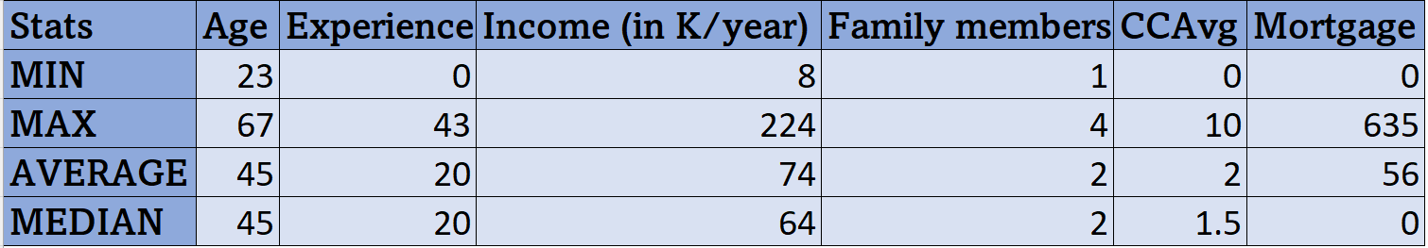
Some Descriptive Stats of the Bank Customers

Slide 6
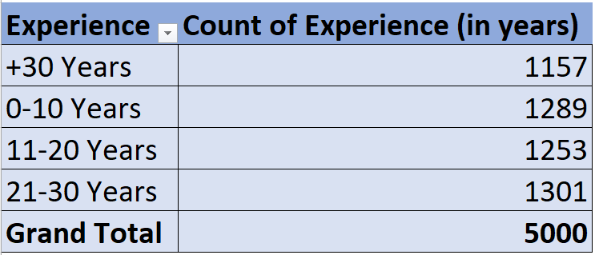
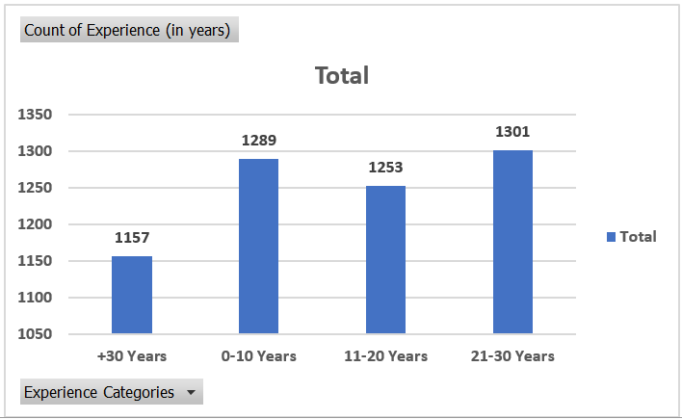
Experience Classification of the Bank Customers

Slide 7
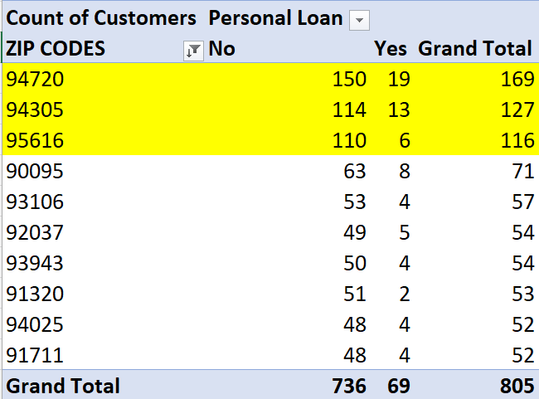
Top Zip Codes where Bank Customers are Located
Physical advertisement concentrated in these Zip Codes might help as almost 1/5th of the customers are in these particular Zip Codes.

Slide 8
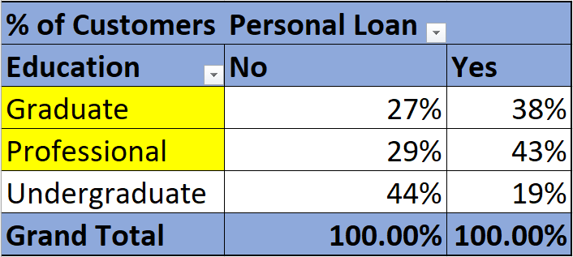
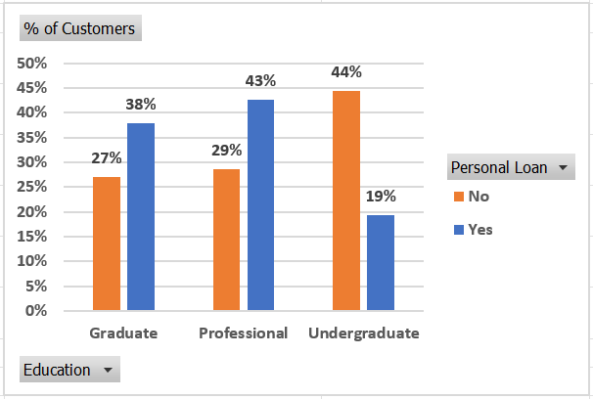
Education vs Personal Loan
We can clearly see that 81% of those who have taken personal loans are either Professional or Graduate.

Slide 9
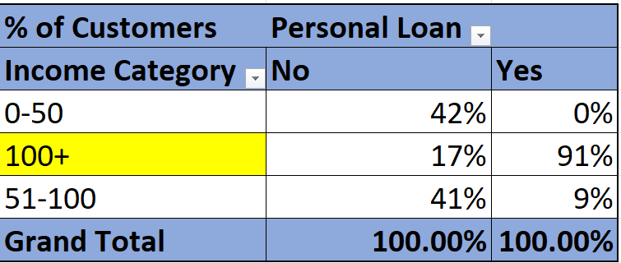
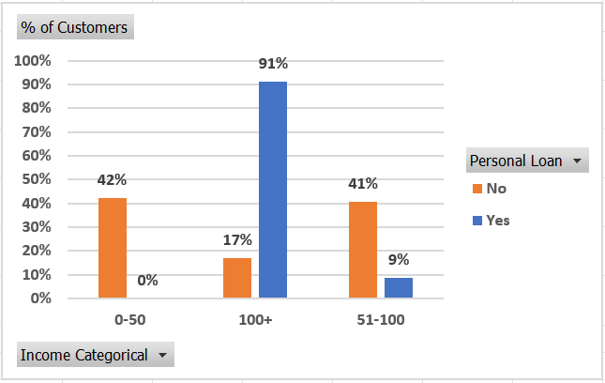
Income Category Vs Personal Loans
91% of those who have taken personal loans have an income of more than 100k/year.

Slide 10
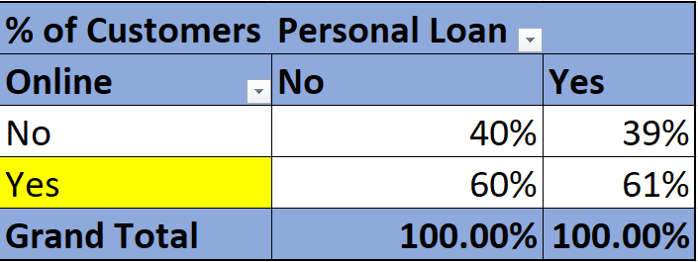
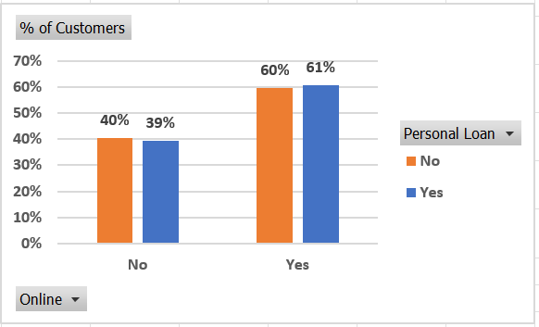
Online Vs Personal Loan
61% of those who have taken personal loans use an Online Banking facility.

Slide 11
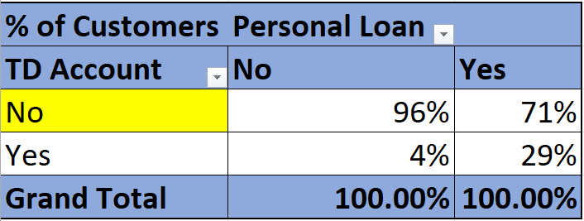
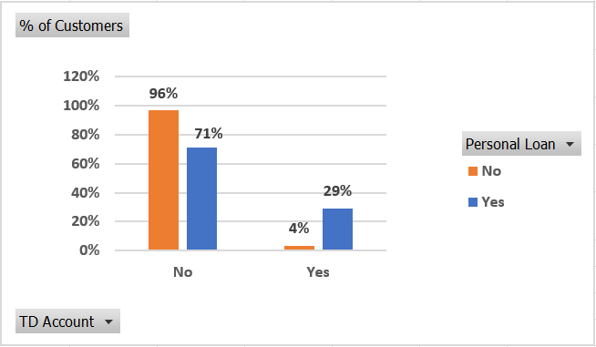
TD Account Vs Personal Loan
71% of those who have taken loans do not have a TD account.

Slide 12
Important data points
39% of those who have both Term Deposit and Credit Card have taken a Personal loan
The Median Income of those who have taken a personal loan is 142.5K/ year while those who have not taken one is 59.
81% of those who have taken personal loans are either Professional or Graduate.
91% of those who have taken personal loans have an income of more than 100k/year.
61% of those who have taken personal loans use an Online Banking facility.
71% of those who have taken loans do not have a TD account.

Slide 13
Customer Base Which Has a Higher Chance of Availing Personal Loan
Customers who are either Professional or Graduate
Customers whose annual income is greater than 100k/Year. Avoid customers whose annual income is less than 50k/Year.
Customers who do not have a Term Deposit Account
Customers who use online Internet banking facilities.
The bank should consider sending Personal Loan offers to customers who meet the above-mentioned criteria.

